Slide 1
Design Patterns
Mohammadreza Tarkhan

Slide 2
Design Patterns classification
Creational patterns
Structural patterns
Behavioral patterns
Architectural pattern

Slide 3
Structural patterns
Decorator
Adapter
Bridge
Composite
Facade
Flyweight
Proxy

Slide 4
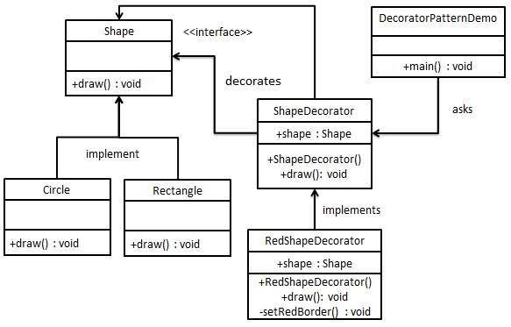
Decorator
Responsibilities should be added to (and removed from) an object dynamically at run-time
A flexible alternative to subclassing for extending functionality should be provided.
Solution:
implement the interface of the extended (decorated) object (Component) transparently by forwarding all requests to it and perform additional functionality before/after forwarding a request.

Slide 5
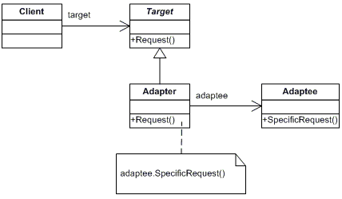
Adapter
How can a class be reused that does not have an interface that a client requires?
How can classes that have incompatible interfaces work together?
How can an alternative interface be provided for a class?
Solution:
Define a separate adapter class that converts the (incompatible) interface of a class (adaptee) into another interface (target) clients require.
Work through an adapter to work with (reuse) classes that do not have the required interface.

Slide 6
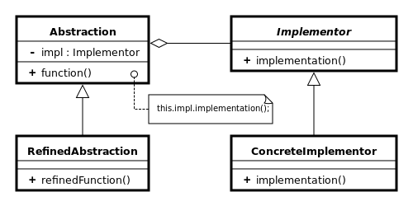
Bridge
An abstraction and its implementation should be defined and extended independently from each other.
A compile-time binding between an abstraction and its implementation should be avoided so that an implementation can be selected at run-time.
Solution:
Separate an abstraction from its implementation by putting them in separate class hierarchies.
Implement the Abstraction in terms of (by delegating to) an Implementor object.
Bridge also differs from Adapter in that Bridge is used when designing new systems while Adapter is used to adapt old systems to new ones.

Slide 7
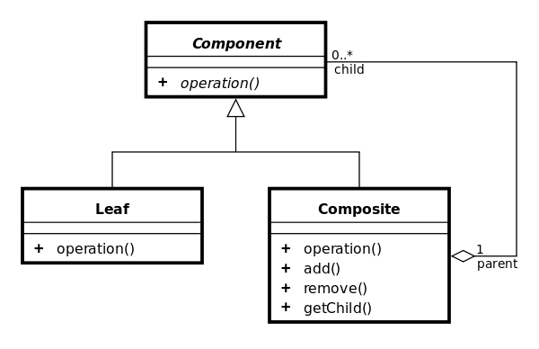
Composite
A part-whole hierarchy should be represented so that clients can treat part and whole objects uniformly.
A part-whole hierarchy should be represented as tree structure.
Solution:
Define a unified Component interface for both part (Leaf) objects and whole (Composite) objects.
Individual Leaf objects implement the Component interface directly, and Composite objects forward requests to their child components.

Slide 8
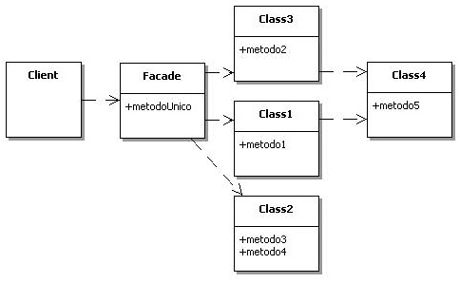
Facade
To make a complex subsystem easier to use, a simple interface should be provided for a set of interfaces in the subsystem.
The dependencies on a subsystem should be minimized.
Solution:
implements a simple interface in terms of (by delegating to) the interfaces in the subsystem and may perform additional functionality before/after forwarding a request.

Slide 9
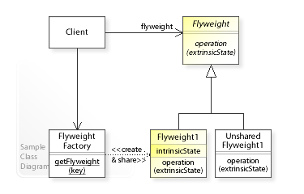
Flyweight
Large numbers of objects should be supported efficiently.
Creating large numbers of objects should be avoided.
Solution:
store intrinsic (invariant) state that can be shared and provide an interface through which extrinsic (variant) state can be passed in

Slide 10
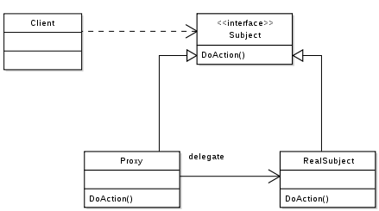
Proxy
The access to an object should be controlled.
Additional functionality should be provided when accessing an object.
Solution:
can be used as substitute for another object (Subject) and
implements additional functionality to control the access to this subject.

Slide 11
Facade vs Adapter vs Decorator
Pattern | Intent
Adapter | Converts one interface to another so that it matches what the client is expecting
Decorator | Dynamically adds responsibility to the interface by wrapping the original code
Facade | Provides a simplified interface

Slide 12
References
Wikipedia

